Slide 1
INFOSYS SPRINGBOARD • VIRTUAL INTERNSHIP 7.0
SUPPLY CHAIN VISIBILITY SYSTEM WITH OPTIMIZATION ANALYTICS
80,519
SUPPLY CHAIN RECORDS
An Interactive Power BI Dashboard for Supply Chain Performance Analysis
17.83%
54.82%
ON-TIME
LATE
Team Members: Uppala Bhavya Sri | V. Charita Sree Velpuri Sai Rohitha | Venkata Puneeth Kothapalli | Yuvasree P Team D • Group 1 Mentor: Ms. Nityasree
POWER BI
ANALYTICS • VISIBILITY • INSIGHTS

Slide 2
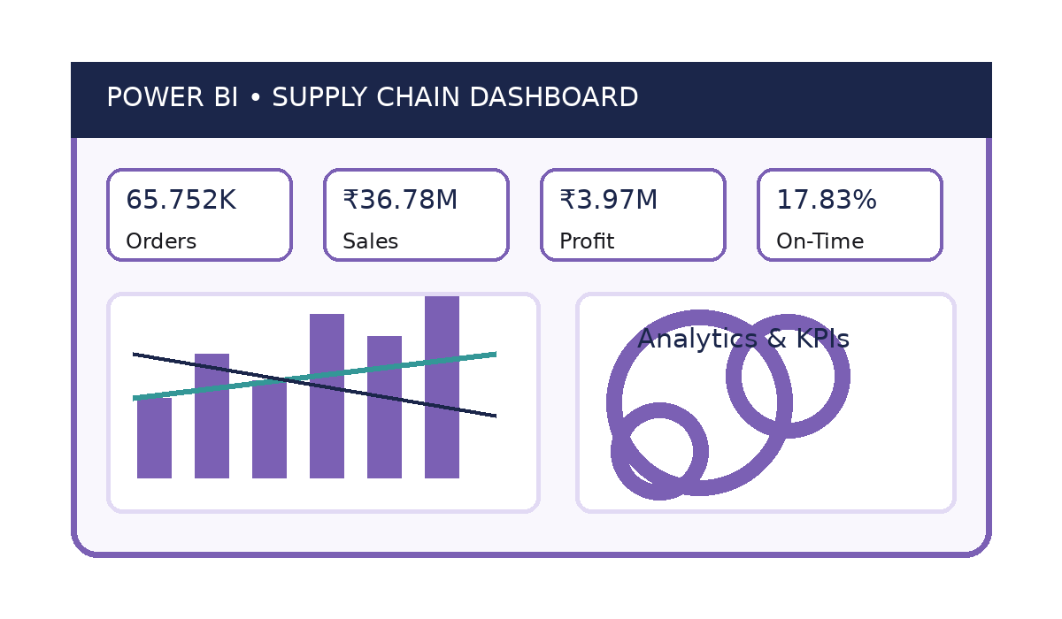
PROJECT OBJECTIVE
02
Project Objective
• Transform raw supply chain data into meaningful visual insights.
• Analyze sales, orders, customers, products and delivery operations.
• Evaluate geographic markets, costs, discounts and profitability.
• Develop interactive Power BI dashboards for data-driven decisions.
Project Modules
Sales & Delivery Analysis • Customer & Product Insights
Geographic & Market Performance • Cost & Profitability
Order Value & Performance Insights

Slide 3
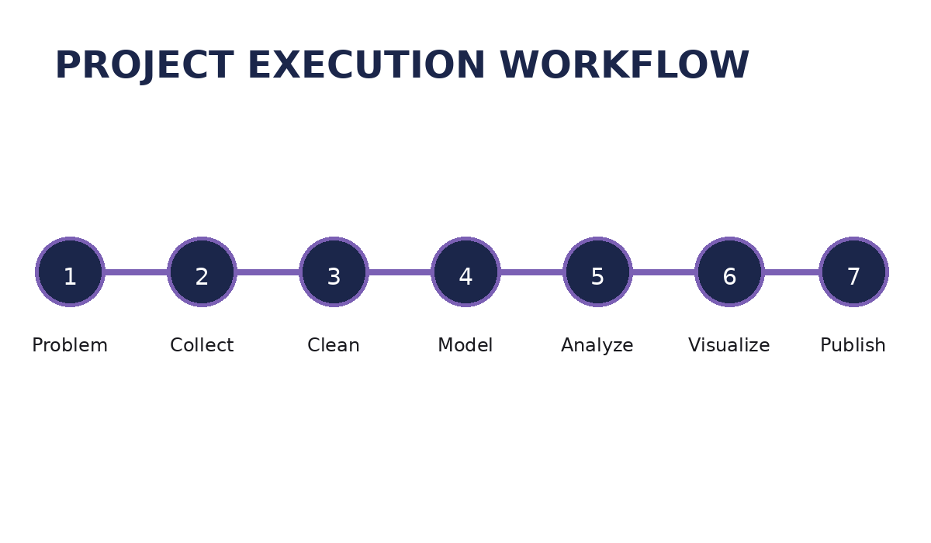
PROJECT EXECUTION MILESTONES
03
Milestone 1 – Data Acquisition & Cleaning
Studied the DataCoSupplyChainDataset and prepared the data using Power Query.
Milestone 2 – Data Modeling
Structured the data and created DAX measures for sales, profit, orders, customers and delivery.
Milestone 3 – Development
Built interactive Power BI dashboard pages using suitable analytical visuals.
Milestone 4 – Review & Optimization
Validated calculations and improved dashboard readability, consistency and usability.

Slide 4
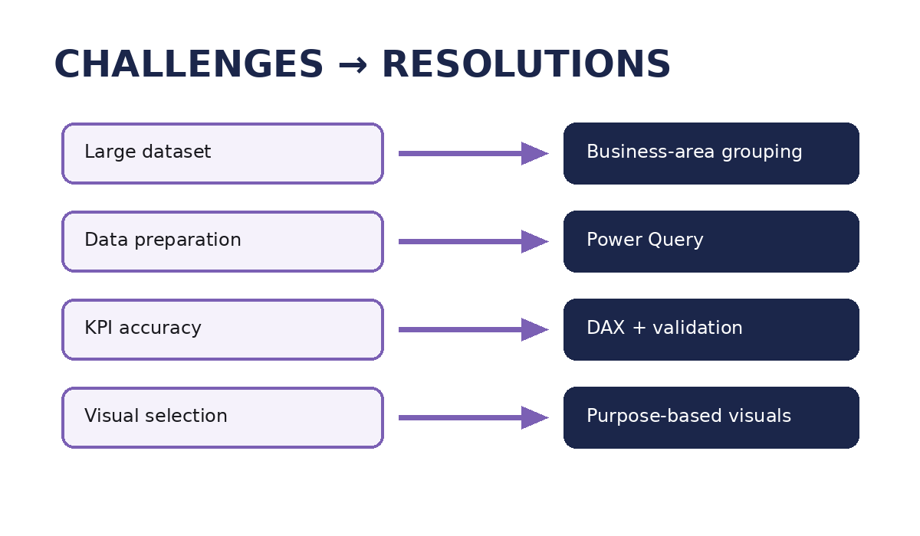
CHALLENGES & RESOLUTIONS
04
Challenges
• Understanding a large dataset with approximately 80,519 records.
• Preparing and transforming raw data accurately.
• Creating accurate KPIs and DAX measures.
• Selecting suitable visuals without unnecessary repetition.
• Maintaining dashboard layout, readability and consistency.
Resolutions
• Grouped fields by business area and used Power Query for preparation.
• Created and validated DAX measures against the dataset.
• Selected visuals according to analytical purpose and organized pages systematically.

Slide 5
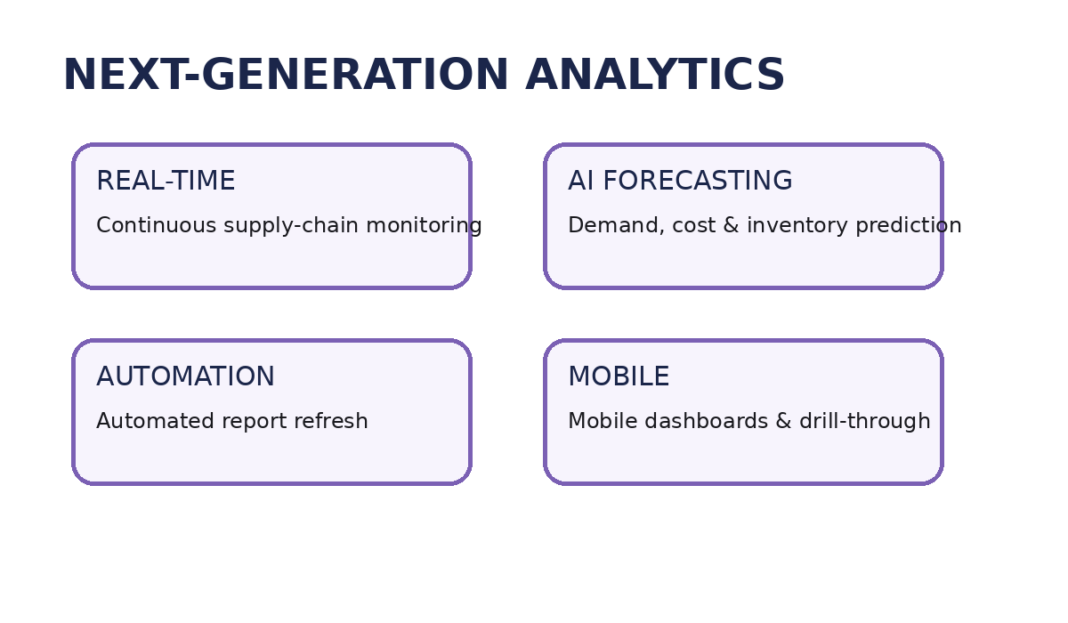
FUTURE ENHANCEMENTS & KEY INSIGHTS
05
Future Enhancements
• Integrate real-time supply chain data.
• Add AI-based forecasting and predictive analytics.
• Implement automated report refresh.
• Develop mobile-friendly dashboards and drill-through reports.
Key Insights
• On-Time Delivery Rate: 17.83% | Late Delivery Rate: 54.82%
• Total Customers: 20,652 | Average Profit per Order: ₹21.98
• Europe contributes approximately ₹10.87M in sales.

Slide 6
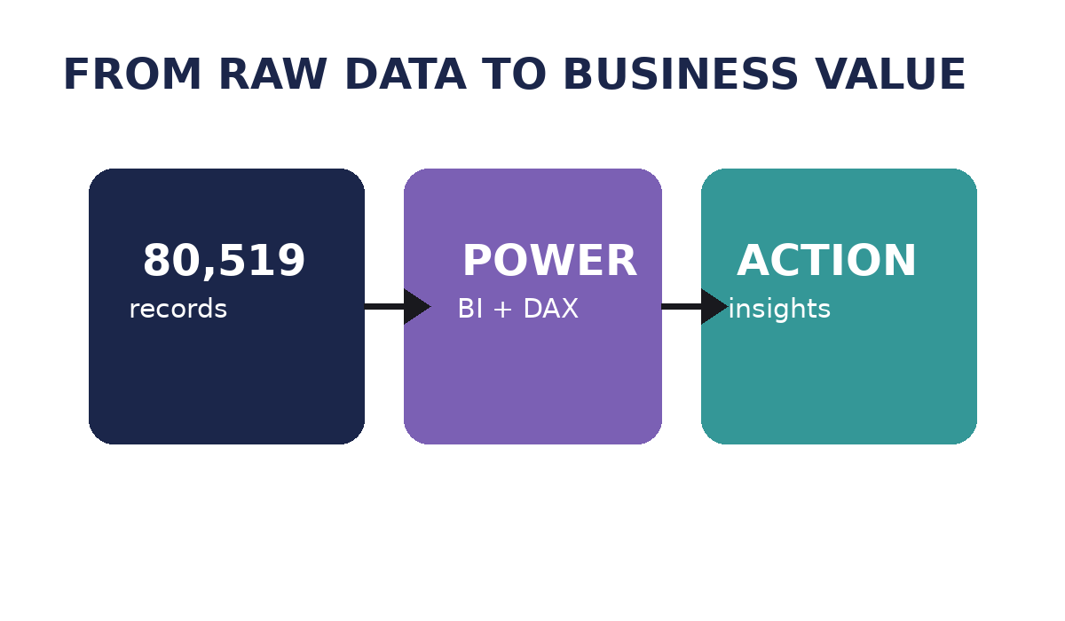
CONCLUSION
06
Supply Chain Visibility and Optimization successfully transformed the DataCoSupplyChainDataset into an interactive Power BI dashboard covering sales, customers, products, delivery, geography, costs and profitability.
Technical Skills
Soft Skills
• Microsoft Power BI
• Power Query Editor
• Problem Solving
• Analytical Thinking
• DAX & Data Modeling
• Data Visualization
• Communication
• Teamwork
• Business Intelligence
• Microsoft Teams
• Presentation
• Time Management
• GitHub
• GitLab
Infosys Springboard – Virtual Internship 7.0

Slide 7
ACKNOWLEDGEMENTS & REFERENCES
07
Acknowledgements
References
• Infosys Springboard – Virtual Internship 7.0
• Mentor – Ms. Nityasree
• Team D – Group 1
• Uppala Bhavya Sri
• V. Charita Sree
• Velpuri Sai Rohitha
• Venkata Puneeth Kothapalli
• Yuvasree P
• DataCoSupplyChainDataset
• Microsoft Power BI Documentation
• Power BI Community Resources
• Kaggle Dataset Resources
• Infosys Springboard Learning Materials
• Microsoft Power Query & DAX resources

Slide 8
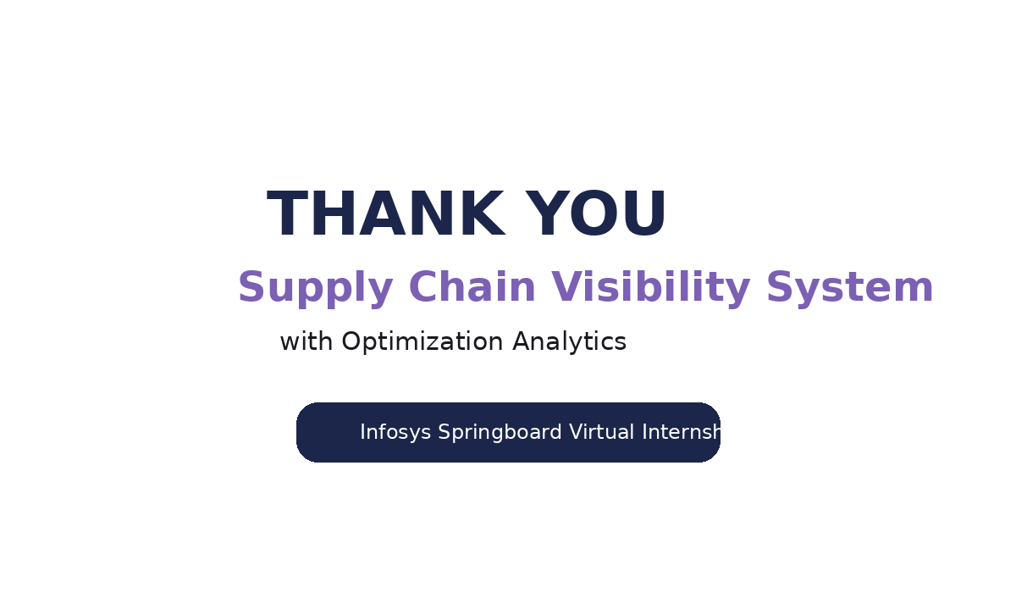
THANK YOU

